Slide 1
Natural Medicine Division
Rulemaking Work Group
Applications & Licensing Procedures
Dominique Mendiola, Allison Robinette, Amelia Myers Department of Revenue Natural Medicine Division
March 20, 2024
Notes:
240320 - Rulemaking Work Group #1
Licensing & Application Requirements & Procedures

Slide 2
Agenda
March 20, 2024
Welcome & Introductions
General Requirements & Initial Definitions
Public Comment
Owner Licenses, Financial Interests, Employee Licenses
Public Comment
Priority Application Review, Location Requirements & Local Jurisdiction Compliance
Public Comment
Next Steps

Slide 3
State Licensing Authority
Powers & Duties to Implement SB23-290
Application Intake: On or before December 31, 2024
Licensing and Enforcement powers
Reporting, Public Education, & First Responder Training duties
Other Duties & Limitations:
Establish an equitable and inclusive program
Establish a testing program
Measures to prevent youth access
Production management
Measures to prevent exploitation & commercialization

Slide 4
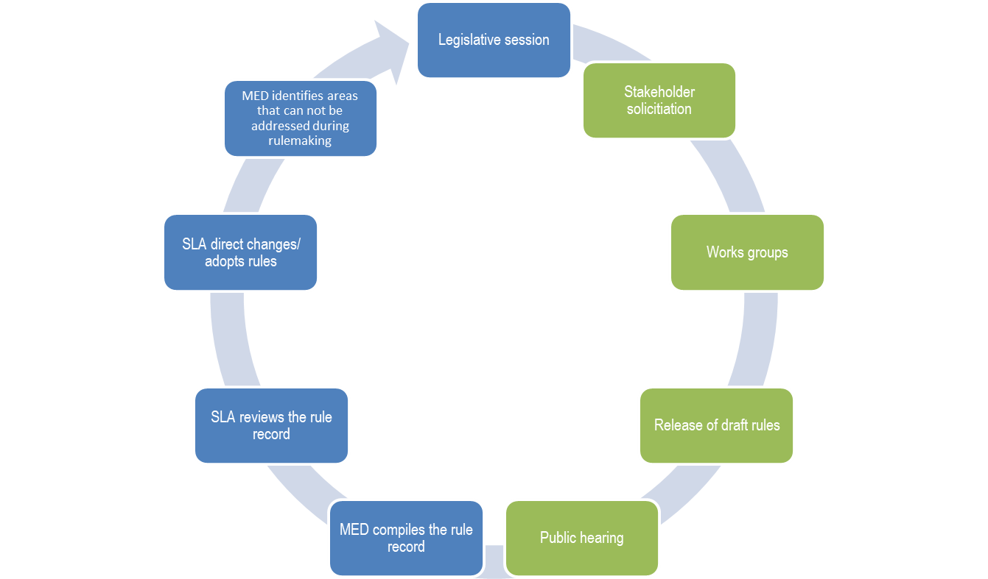
NMD identifies areas that cannot be addressed through rulemaking
We are here
NMD compiles the rule record
Permanent Rulemaking Hearing - July 25, 2024

Slide 5
Engagement & Expectations
Meeting Materials - Available on the NMD Website
Comment Opportunities
Please sign-up to provide comments during the meeting, using the sign in sheet in person, or online
Oral comments during rulemaking meeting will be limited to 3 minutes each
Written public comment form is always available
Business promotion is not appropriate
Respect

Slide 6
NMD Rulemaking Guiding Principles
Rules should be:
TRANSPARENT
SYSTEMATIC
OPERABLE
DEFENSIBLE

Slide 7
Detailed Comment Agenda
March 20, 2024
9:30am - 10:00am - Presentation & Public Comment
General Requirements, Definitions, Application Procedures
10am - 11am - Presentation & Public Comment
Owner & Employee Licenses
11am - 11:50am - Presentation & Public Comment
Priority Application Review, Location Requirements & Local Jurisdiction

Slide 8
Proposed Rules
General Requirements, Definitions, & Application Procedures
Rules 1005 - Applicability
1010 - Severability
1015 - Statements of Position & Declaratory Orders
1020 - Law Enforcement Authority
1025 - Definitions

Slide 9
Proposed Definition
Community Impact Plan
“Community Impact Plan” means an Applicant’s or Licensee’s documented commitment to implement sustainability practices, support social and economic equity in their community, or to provide access to Regulated Natural Medicine to communities that have been disproportionately harmed by high rates of arrest for controlled substances, persons who face barriers to healthcare access, persons who have traditional, tribal or Indigenous history with natural medicine, or veterans.

Slide 10
Proposed Definition
Financial Interest
“Financial Interest” means entitlement or agreement to receive a portion of revenue, proceeds or profits from a Natural Medicine Business or Natural Medicine Business Applicant; or a membership interest, partnership interest or other ownership interest, including but not limited to a share of stock, in a Natural Medicine Business or a Natural Medicine Business Applicant.

Slide 11
Proposed Definition
Owner License
“Owner” means an individual or an entity that owns, possesses, or is entitled to any Financial Interest in a Natural Medicine Business or a Natural Medicine Business Applicant; an individual or an entity that owns a share of stock in a corporation, a membership in a nonprofit corporation, a membership interest in a limited liability company, the interest of a member in a cooperative or in a limited cooperative association, a partnership interest in a limited partnership, a partnership interest in a partnership, or the interest of a member in a limited partnership association that holds any interest in a Natural Medicine Business.

Slide 12
Proposed Rules
General Requirements, Definitions, & Application Procedures
Rules 2105 - Duties of All Applicants & Licensees
2110 - Application Requirements
2125 - Natural Medicine Business
2130 - License Renewal
2155 - Application Denial, Voluntary Withdrawal, and Effect of a License Surrender
2160 - Revoked or Suspended Owner

Slide 13
Public Comments
General Requirements, Definitions, General Application Procedures
Rules 1005 - 1025, 2105, 2110, 2125, 2130, 2155, 2160
Each speaker has 3 minutes.
We will take comments in the order folks sign-up on the comment form.

Slide 14
Proposed Rules
Owner Licenses, Employee Licenses, & Financial Interests
Rules 2115 - Employee Licenses: Initial Application Requirements
2120 - Owner Licenses: Initial Application Requirements
2135 - Licensure Qualifications
2140 - Disclosure of Financial Interests and Owners of Natural Medicine Business License

Slide 15
We are taking a short break and will be back at 10:30

Slide 16
Public Comments
Owner Licenses, Employee Licenses, and Financial Interests
Rules 2115, 2120, 2135, 2140
Each speaker has 3 minutes.
We will take comments in the order folks sign-up on the comment form.

Slide 17
Proposed Rules
Priority Application Review
Location Requirements & Local Jurisdiction Compliance
Rules 2110(E) - General Application Requirements
2125 - Natural Medicine Business: Initial Application Requirements (Premises information & Priority Review))
2150 - Change of Location of Regulated Natural Medicine Business License

Slide 18
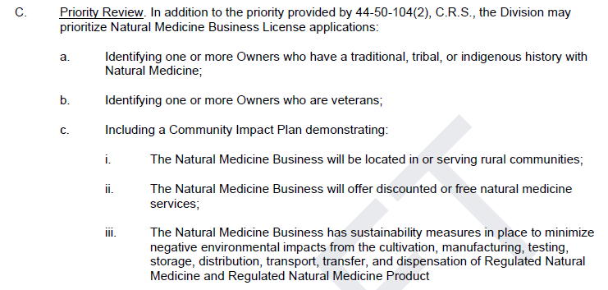
Proposed Rule
Priority Review

Slide 19
Proposed Rules
Priority Application Review
Location Requirements & Local Jurisdiction Compliance
Rules 2110(E) - General Application Requirements
2125 - Natural Medicine Business: Initial Application Requirements (Premises information & Priority Review))
2150 - Change of Location of Regulated Natural Medicine Business License

Slide 20
Public Comments
Priority Application Review
Location Requirements & Local Jurisdiction Compliance
Rules 2110(E), 2125, 2150
Each speaker has 3 minutes.
We will take comments in the order folks sign-up on the comment form.

Slide 21
Wrap Up & Next Steps

Slide 22
DOR Rulemaking Schedule
March 20, 2024: Licensing & Application Requirements & Procedures
April 10, 2024: General Requirements
May 1, 2024: Healing Center Requirements
May 22, 2024: Advertising, Packaging, & Labeling, Recordkeeping Requirements
June 12, 2024: Cultivation & Manufacturing Requirements
June 25, 2024: Testing Requirements & Testing Facilities
July 1, 2024: Fees, Enforcement, Discipline
July 9, 2024: Catch-all
Permanent Rulemaking Hearing - July 25, 2024

Slide 23
Resources Shared During the Meeting
Natural Medicine Division Website
Meeting Agenda
3/20/24 Draft Rules
Form to sign-up for NMD notifications
Public Resources Folder
Written Comment Form
Participant Interest Survey

